Slide 1
Kubernetes

Slide 2
Container Orchestration

Slide 3
Pod, Services, Replicaset and Deployments

Slide 4


Kubernetes Pod
Pod
Container
Notes:
A Pod is the smallest deployable unit in Kubernetes. It represents a single instance of a running process in a cluster, which can be one or more containers packaged together. In Kubernetes containers are run within Pods, and these Pods are scheduled and managed by Kubernetes.
A Service is used to expose a set of Pods as a network service within the cluster. It provides a stable endpoint (usually an IP address and port) to access the Pods behind it.

Slide 5
Kubernetes Pod
Pod
Container
Pods are ephemeral
Notes:
A Pod is the smallest deployable unit in Kubernetes. It represents a single instance of a running process in a cluster, which can be one or more containers packaged together. In Kubernetes containers are run within Pods, and these Pods are scheduled and managed by Kubernetes.
A Service is used to expose a set of Pods as a network service within the cluster. It provides a stable endpoint (usually an IP address and port) to access the Pods behind it.

Slide 6
Kubernetes Pod
Pod
Container
Pods are ephemeral
Notes:
A Pod is the smallest deployable unit in Kubernetes. It represents a single instance of a running process in a cluster, which can be one or more containers packaged together. In Kubernetes containers are run within Pods, and these Pods are scheduled and managed by Kubernetes.
A Service is used to expose a set of Pods as a network service within the cluster. It provides a stable endpoint (usually an IP address and port) to access the Pods behind it.

Slide 7

Kubernetes Pods and Services
EKS Cluster
Pod
Container
Service
Notes:
A Pod is the smallest deployable unit in Kubernetes. It represents a single instance of a running process in a cluster, which can be one or more containers packaged together. In Kubernetes containers are run within Pods, and these Pods are scheduled and managed by Kubernetes.
A Service is used to expose a set of Pods as a network service within the cluster. It provides a stable endpoint (usually an IP address and port) to access the Pods behind it.

Slide 8
Kubernetes Pods and Services
Pod
Container
Service
172.18.92.62
Notes:
A Pod is the smallest deployable unit in Kubernetes. It represents a single instance of a running process in a cluster, which can be one or more containers packaged together. In Kubernetes containers are run within Pods, and these Pods are scheduled and managed by Kubernetes.
A Service is used to expose a set of Pods as a network service within the cluster. It provides a stable endpoint (usually an IP address and port) to access the Pods behind it.

Slide 9
Kubernetes Pods and Services
Pod
Container
Service
172.37.19.84
Notes:
A Pod is the smallest deployable unit in Kubernetes. It represents a single instance of a running process in a cluster, which can be one or more containers packaged together. In Kubernetes containers are run within Pods, and these Pods are scheduled and managed by Kubernetes.
A Service is used to expose a set of Pods as a network service within the cluster. It provides a stable endpoint (usually an IP address and port) to access the Pods behind it.

Slide 10
Kubernetes Pods and Services
Service
172.18.92.62
Pod
Container
172.18.92.62
Notes:
A Pod is the smallest deployable unit in Kubernetes. It represents a single instance of a running process in a cluster, which can be one or more containers packaged together. In Kubernetes containers are run within Pods, and these Pods are scheduled and managed by Kubernetes.
A Service is used to expose a set of Pods as a network service within the cluster. It provides a stable endpoint (usually an IP address and port) to access the Pods behind it.

Slide 11

Kubernetes Pods and Services
Service
172.37.19.84
Pod
Pod
Container
Container
172.18.92.62
172.37.19.84
Notes:
A Pod is the smallest deployable unit in Kubernetes. It represents a single instance of a running process in a cluster, which can be one or more containers packaged together. In Kubernetes containers are run within Pods, and these Pods are scheduled and managed by Kubernetes.
A Service is used to expose a set of Pods as a network service within the cluster. It provides a stable endpoint (usually an IP address and port) to access the Pods behind it.

Slide 12
Kubernetes Pods and Services
Service
172.37.19.84
app = frontend
app = frontend
Pod
Pod
Container
Container
172.18.92.62
172.37.19.84
Notes:
A Pod is the smallest deployable unit in Kubernetes. It represents a single instance of a running process in a cluster, which can be one or more containers packaged together. In Kubernetes containers are run within Pods, and these Pods are scheduled and managed by Kubernetes.
A Service is used to expose a set of Pods as a network service within the cluster. It provides a stable endpoint (usually an IP address and port) to access the Pods behind it.

Slide 13
Kubernetes Replicaset
Replica
5
Pod
Pod
Pod
Pod
Pod
Container
Container
Container
Container
Container
172.18.92.62
172.37.19.84
172.128.245.67
172.198.3.140
172.20.22.77
Notes:
A Pod is the smallest deployable unit in Kubernetes. It represents a single instance of a running process in a cluster, which can be one or more containers packaged together. In Kubernetes containers are run within Pods, and these Pods are scheduled and managed by Kubernetes.
A Service is used to expose a set of Pods as a network service within the cluster. It provides a stable endpoint (usually an IP address and port) to access the Pods behind it.

Slide 14
Kubernetes Replicaset: Scalabilty
Pod
Pod
Pod
Pod
Pod
Container
Container
Container
Container
Container
172.18.92.62
172.37.19.84
172.128.245.67
172.198.3.140
172.20.22.77
Pod
Pod
Pod
Pod
Pod
Container
Container
Container
Container
Container
172.37.228.10
172.123.57.189
172.85.43.212
172.240.96.174
172.59.118.6
Notes:
A Pod is the smallest deployable unit in Kubernetes. It represents a single instance of a running process in a cluster, which can be one or more containers packaged together. In Kubernetes containers are run within Pods, and these Pods are scheduled and managed by Kubernetes.
A Service is used to expose a set of Pods as a network service within the cluster. It provides a stable endpoint (usually an IP address and port) to access the Pods behind it.

Slide 15
Kubernetes Replicaset: High Availability
Replica
5
Pod
Pod
Pod
Pod
Pod
Container
Container
Container
Container
Container
172.18.92.62
172.37.19.84
172.128.245.67
172.198.3.140
172.20.22.77
Notes:
A Pod is the smallest deployable unit in Kubernetes. It represents a single instance of a running process in a cluster, which can be one or more containers packaged together. In Kubernetes containers are run within Pods, and these Pods are scheduled and managed by Kubernetes.
A Service is used to expose a set of Pods as a network service within the cluster. It provides a stable endpoint (usually an IP address and port) to access the Pods behind it.

Slide 16
Kubernetes Replicaset: High Availability
Replica
5
Pod
Pod
Pod
Pod
Pod
Container
Container
Container
Container
Container
172.18.92.62
172.37.19.84
172.128.245.67
172.198.3.140
172.20.22.77
Notes:
A Pod is the smallest deployable unit in Kubernetes. It represents a single instance of a running process in a cluster, which can be one or more containers packaged together. In Kubernetes containers are run within Pods, and these Pods are scheduled and managed by Kubernetes.
A Service is used to expose a set of Pods as a network service within the cluster. It provides a stable endpoint (usually an IP address and port) to access the Pods behind it.

Slide 17
Kubernetes Replicaset: High Availability
Replica
5
Pod
Pod
Pod
Pod
Pod
Container
Container
Container
Container
Container
172.18.92.62
172.37.19.84
172.128.245.67
172.54.111.203
172.210.189.80
Notes:
A Pod is the smallest deployable unit in Kubernetes. It represents a single instance of a running process in a cluster, which can be one or more containers packaged together. In Kubernetes containers are run within Pods, and these Pods are scheduled and managed by Kubernetes.
A Service is used to expose a set of Pods as a network service within the cluster. It provides a stable endpoint (usually an IP address and port) to access the Pods behind it.

Slide 18
Kubernetes Deployment
Deployment
ReplicaSet
Pod
Container
Notes:
Containers: Containers are lightweight, standalone, and executable software packages that include everything needed to run a piece of software, including the code, runtime, libraries, and system tools. They provide consistency and portability across different environments.
Pods: Pods are the smallest deployable units in Kubernetes. They represent one or more closely related containers that share the same network and storage resources.
ReplicaSets: A ReplicaSet is a Kubernetes resource used to ensure that a specified number of replica Pods are running at all times. It is often used for maintaining the desired level of availability and scaling of Pods.
Deployments: Deployments are a higher-level abstraction that manages ReplicaSets and Pods, making it easier to declaratively define and manage the desired state of your application. Deployments enable features like rolling updates and rollbacks, ensuring application availability and reliability.

Slide 19
Kubernetes Deployment
Deployment
ReplicaSet
Pod
Container
Service
Notes:
Containers: Containers are lightweight, standalone, and executable software packages that include everything needed to run a piece of software, including the code, runtime, libraries, and system tools. They provide consistency and portability across different environments.
Pods: Pods are the smallest deployable units in Kubernetes. They represent one or more closely related containers that share the same network and storage resources.
ReplicaSets: A ReplicaSet is a Kubernetes resource used to ensure that a specified number of replica Pods are running at all times. It is often used for maintaining the desired level of availability and scaling of Pods.
Deployments: Deployments are a higher-level abstraction that manages ReplicaSets and Pods, making it easier to declaratively define and manage the desired state of your application. Deployments enable features like rolling updates and rollbacks, ensuring application availability and reliability.

Slide 20
Kubernetes Deployment
Pod
Pod
Pod
Container
Container
Container
172.18.92.62
172.37.19.84
172.128.245.67
Pod
Pod
Docker Image (v1)
Container
Container
172.198.3.140
172.20.22.77
Notes:
A Pod is the smallest deployable unit in Kubernetes. It represents a single instance of a running process in a cluster, which can be one or more containers packaged together. In Kubernetes containers are run within Pods, and these Pods are scheduled and managed by Kubernetes.
A Service is used to expose a set of Pods as a network service within the cluster. It provides a stable endpoint (usually an IP address and port) to access the Pods behind it.

Slide 21
Kubernetes Deployment
Pod
Pod
Pod
Container
Container
Container
172.18.92.62
172.37.19.84
172.128.245.67
Pod
Pod
Docker Image (v2)
Container
Container
172.198.3.140
172.20.22.77
Notes:
A Pod is the smallest deployable unit in Kubernetes. It represents a single instance of a running process in a cluster, which can be one or more containers packaged together. In Kubernetes containers are run within Pods, and these Pods are scheduled and managed by Kubernetes.
A Service is used to expose a set of Pods as a network service within the cluster. It provides a stable endpoint (usually an IP address and port) to access the Pods behind it.

Slide 22
Kubernetes Cluster
Deployment
ReplicaSet
Pod
Pod
Pod
Container
Container
Container

Slide 23
EKS

Slide 24

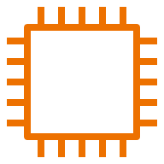
EKS Cluster
AWS VPC
EKS Control Plane
Kubectl
Worker VPC

Slide 25

EKS
EKS With Fargate
Pod
Pod
Pod
Pod
Notes:
An EKS (Elastic Kubernetes Service) cluster with Fargate is a Kubernetes cluster managed by AWS that utilizes Fargate as the compute engine for running Pods.
Fargate eliminates the need to manage EC2 instances, providing a serverless and fully managed platform for containerized applications.
This combination simplifies cluster management, improves resource utilization, and allows for efficient scaling, making it an ideal choice for modern cloud-native deployments.

Slide 26
EKS
EKS With EC2
EC2
EC2
EC2
EC2
Pod
Pod
Pod
Pod
Notes:
An EKS (Elastic Kubernetes Service) cluster with EC2 (Elastic Compute Cloud) leverages EC2 instances as the compute resource for running Pods within the Kubernetes cluster. EKS abstracts the underlying infrastructure, making it easier to deploy, manage, and scale containerized applications. EC2 instances can be customized based on specific requirements, offering flexibility and control over the cluster's compute resources. This combination allows for a wide range of use cases, from traditional applications to more complex workloads, within the Kubernetes ecosystem.

Slide 27


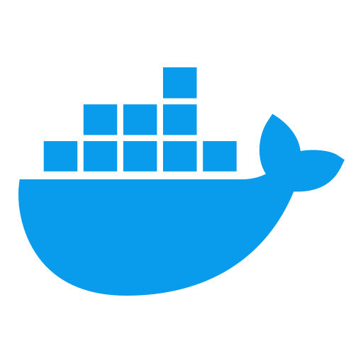
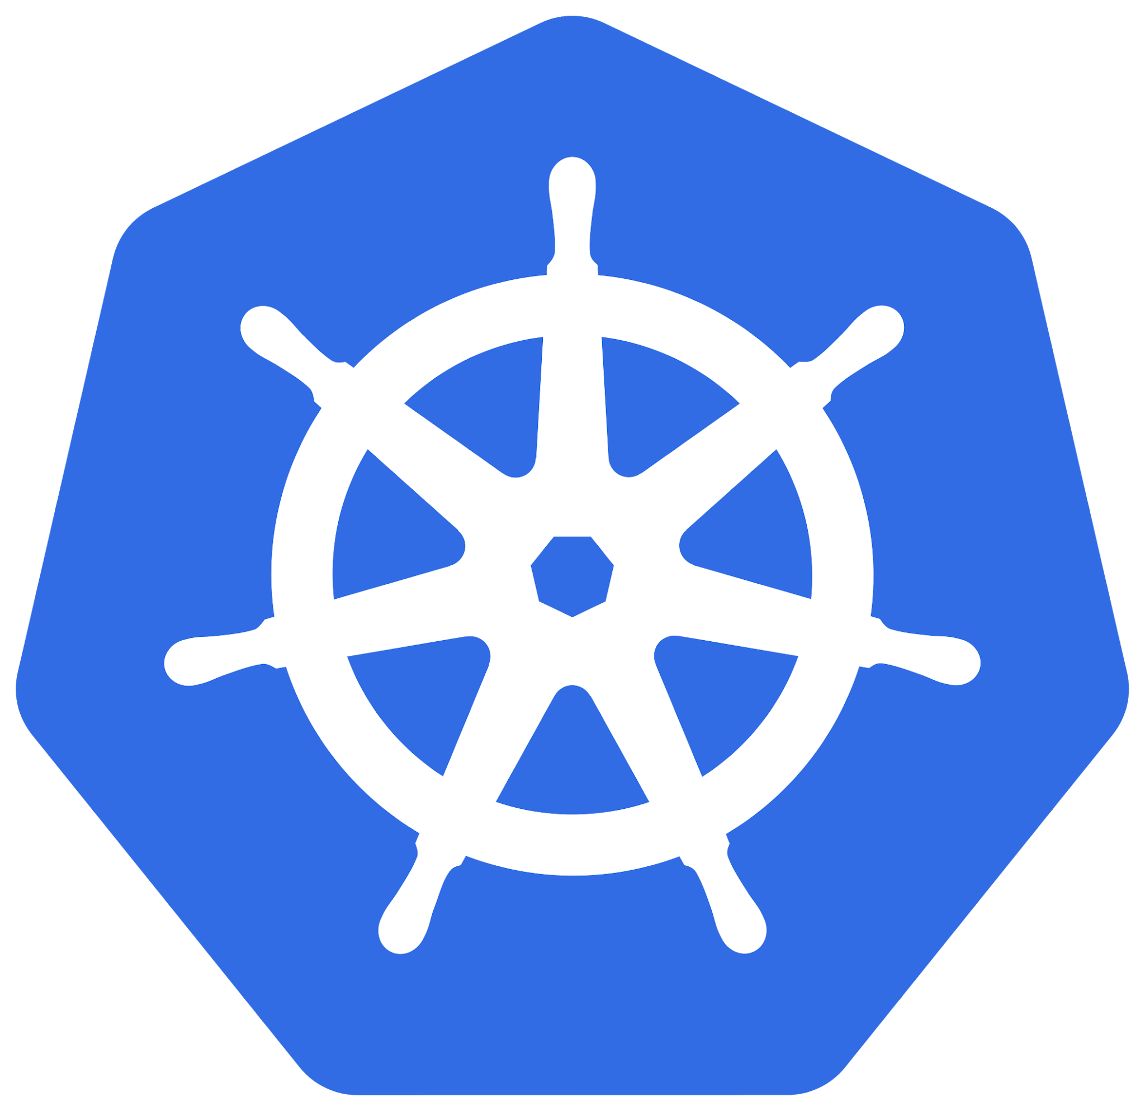
Jenkins CI/CD Pipeline
Performs Unit Testing
Builds and publishes Docker Image
Deploys to EKS cluster

Slide 28

Jenkins With EKS
Source Code Repository
CI/CD Pipeline (Build and Deploy to staging)

Slide 29


Jenkins With EKS
Web App
Traffic

Slide 30
Kubernetes

Slide 31
What is Container Orchestration?

Slide 32

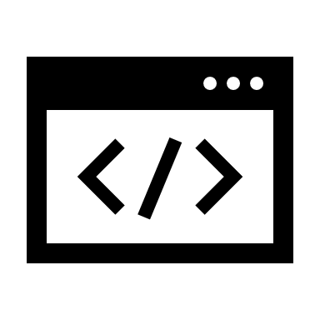
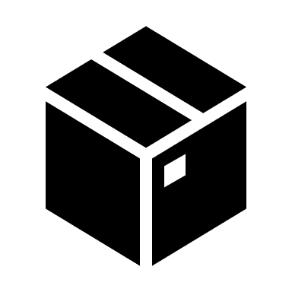
Kubernetes Pods and Services
Kubernetes Cluster
Pod
Container
Service
Notes:
A Pod is the smallest deployable unit in Kubernetes. It represents a single instance of a running process in a cluster, which can be one or more containers packaged together. In Kubernetes containers are run within Pods, and these Pods are scheduled and managed by Kubernetes.
A Service is used to expose a set of Pods as a network service within the cluster. It provides a stable endpoint (usually an IP address and port) to access the Pods behind it.

Slide 33
Kubernetes Objects
Deployment
Replicaset
Pod
Container
Notes:
Containers: Containers are lightweight, standalone, and executable software packages that include everything needed to run a piece of software, including the code, runtime, libraries, and system tools. They provide consistency and portability across different environments.
Pods: Pods are the smallest deployable units in Kubernetes. They represent one or more closely related containers that share the same network and storage resources.
ReplicaSets: A ReplicaSet is a Kubernetes resource used to ensure that a specified number of replica Pods are running at all times. It is often used for maintaining the desired level of availability and scaling of Pods.
Deployments: Deployments are a higher-level abstraction that manages ReplicaSets and Pods, making it easier to declaratively define and manage the desired state of your application. Deployments enable features like rolling updates and rollbacks, ensuring application availability and reliability.

Slide 34
EKS

Slide 35
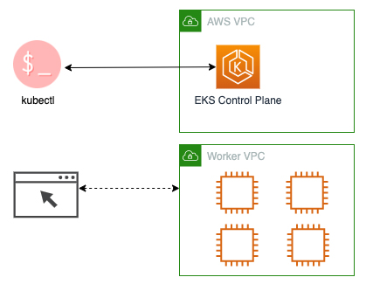
EKS Cluster

Slide 36
EKS
EKS with Fargate
Pod
Pod
Pod
Pod
Notes:
An EKS (Elastic Kubernetes Service) cluster with Fargate is a Kubernetes cluster managed by AWS that utilizes Fargate as the compute engine for running Pods.
Fargate eliminates the need to manage EC2 instances, providing a serverless and fully managed platform for containerized applications.
This combination simplifies cluster management, improves resource utilization, and allows for efficient scaling, making it an ideal choice for modern cloud-native deployments.

Slide 37
EKS
EKS with EC2
EC2
EC2
EC2
EC2
Pod
Pod
Pod
Pod
Notes:
An EKS (Elastic Kubernetes Service) cluster with EC2 (Elastic Compute Cloud) leverages EC2 instances as the compute resource for running Pods within the Kubernetes cluster. EKS abstracts the underlying infrastructure, making it easier to deploy, manage, and scale containerized applications. EC2 instances can be customized based on specific requirements, offering flexibility and control over the cluster's compute resources. This combination allows for a wide range of use cases, from traditional applications to more complex workloads, within the Kubernetes ecosystem.

Slide 38
Jenkins CICD Pipeline
Perform Unit Testing
Build Docker Image
Publish Docker Image
Deploy to EKS cluster

Slide 39
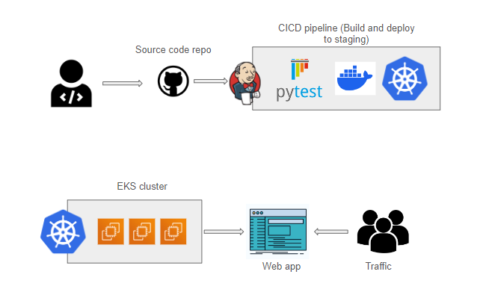
Jenkins with EKS

